Slide 1


ECO GLOBAL ENGINEERING INCORPORATION
(ECOGEI)
REPUBLIC OF SINGAPORE
An Advanced R&D Based Environmental cum Mechanical Global Engineering Enterprise
CORPORATE PRESENTATION

Slide 2
Who We Are:
• Innovative R&D based Manufacturer and Global Distributor of Various Ranges of Ultra Modern Organic Waste Management Products and Impure, Chemical, Industrial Waste Water of any kind and Brackish Water Purifiers using Highly Sophisticated Technologies, Headquartered in Singapore
• R&D Team and Microbes Specialization Team in Singapore
• Solution Providers on Environmental Issues and Related Engineering

Slide 3
ECO GLOBAL ENGINEERING INCORPORATION (ECOGEI) REPUBLIC OF SINGAPORE
In Collaboration & Tie up with Giant Companies of the Following Countries:
UNITED KINGDOM (UK)
MALAYSIA
UNITED STATES OF AMERICA (USA)

Slide 4

ECOGEI GROUP, SINGAPORE
3 Overseas offices in:
United Kingdom
Singapore
Malaysia
Republic of India
Manufacturing Facility in Singapore, UK and Malaysia

Slide 5
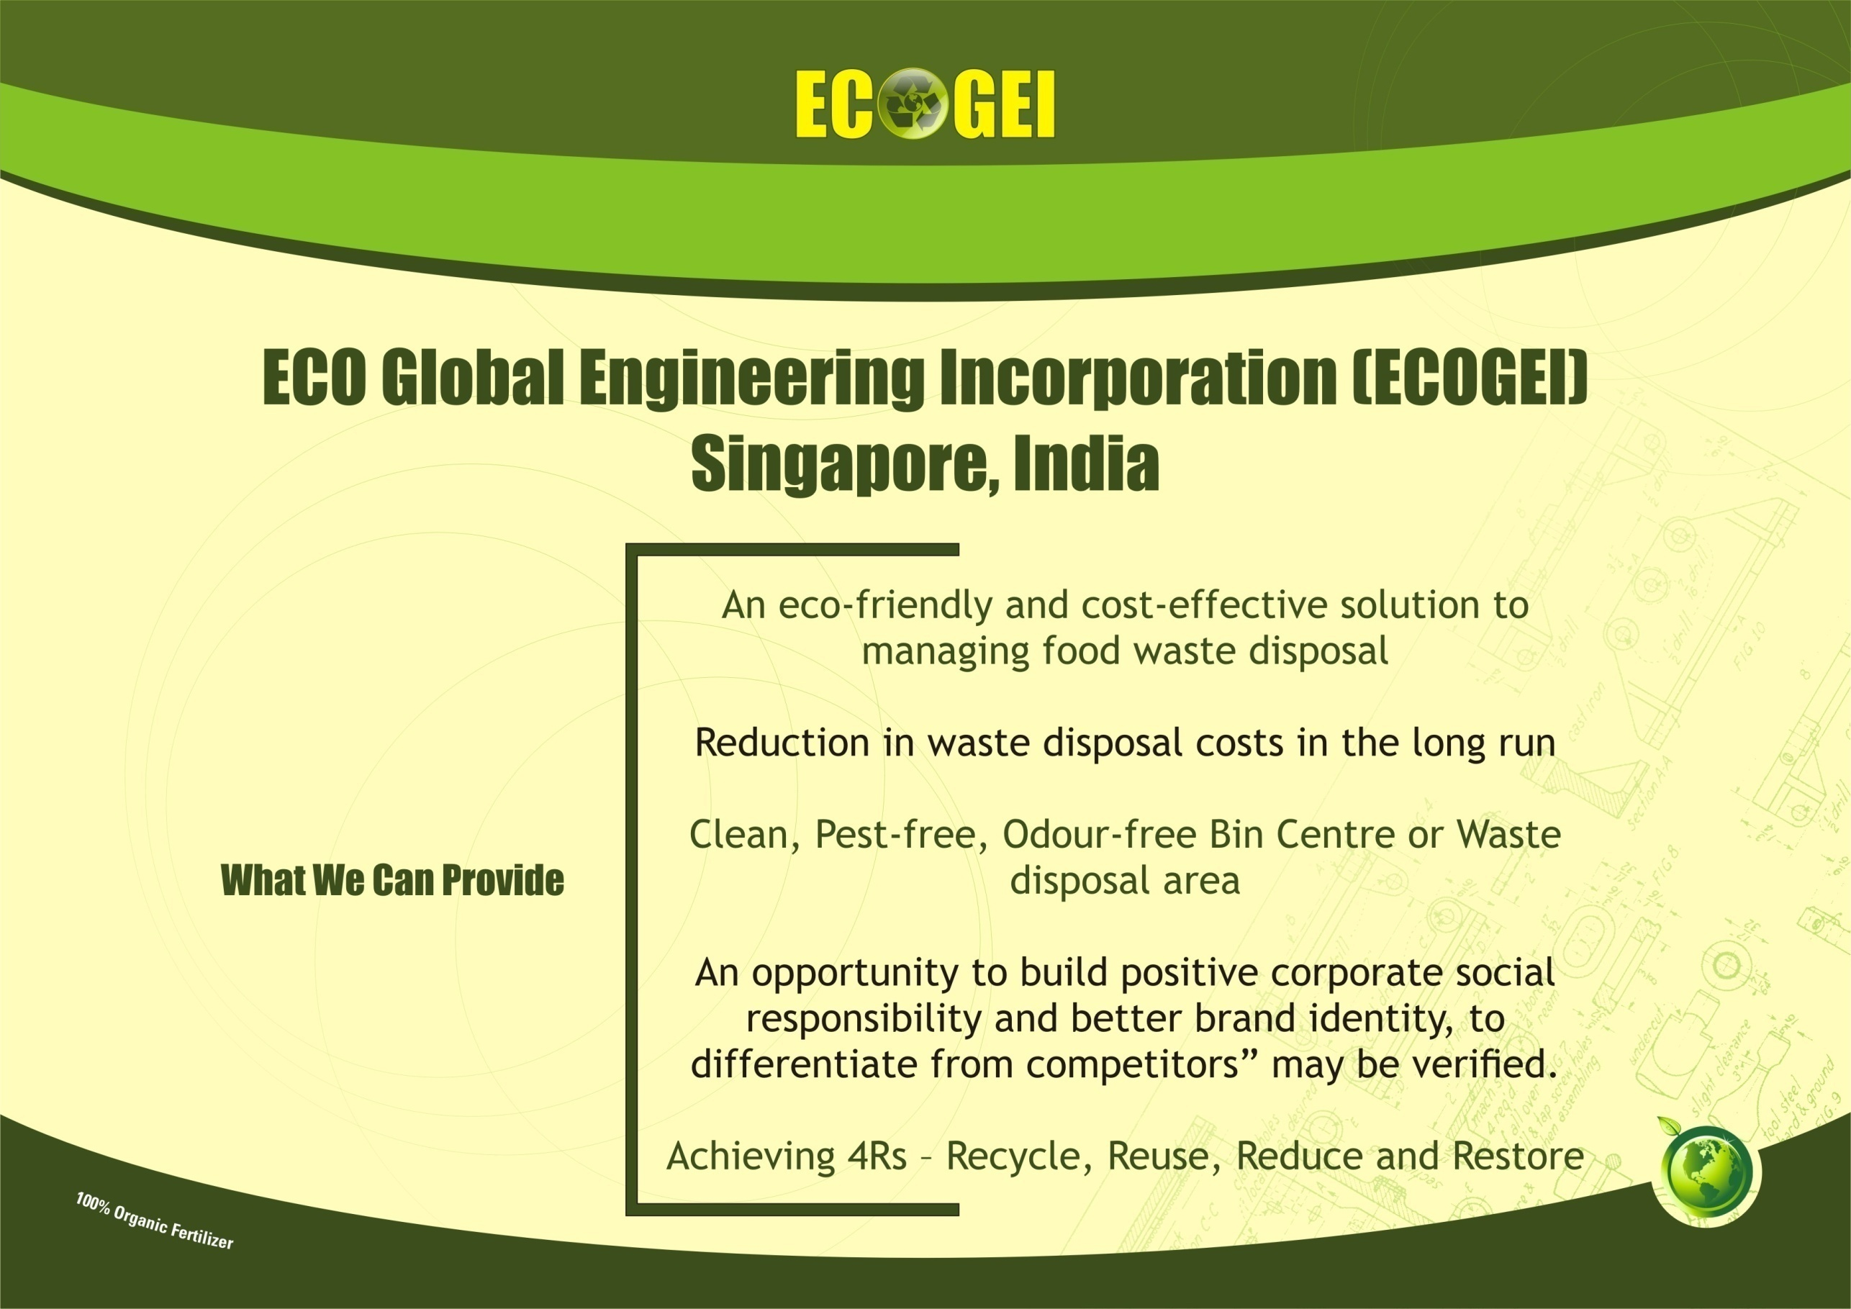
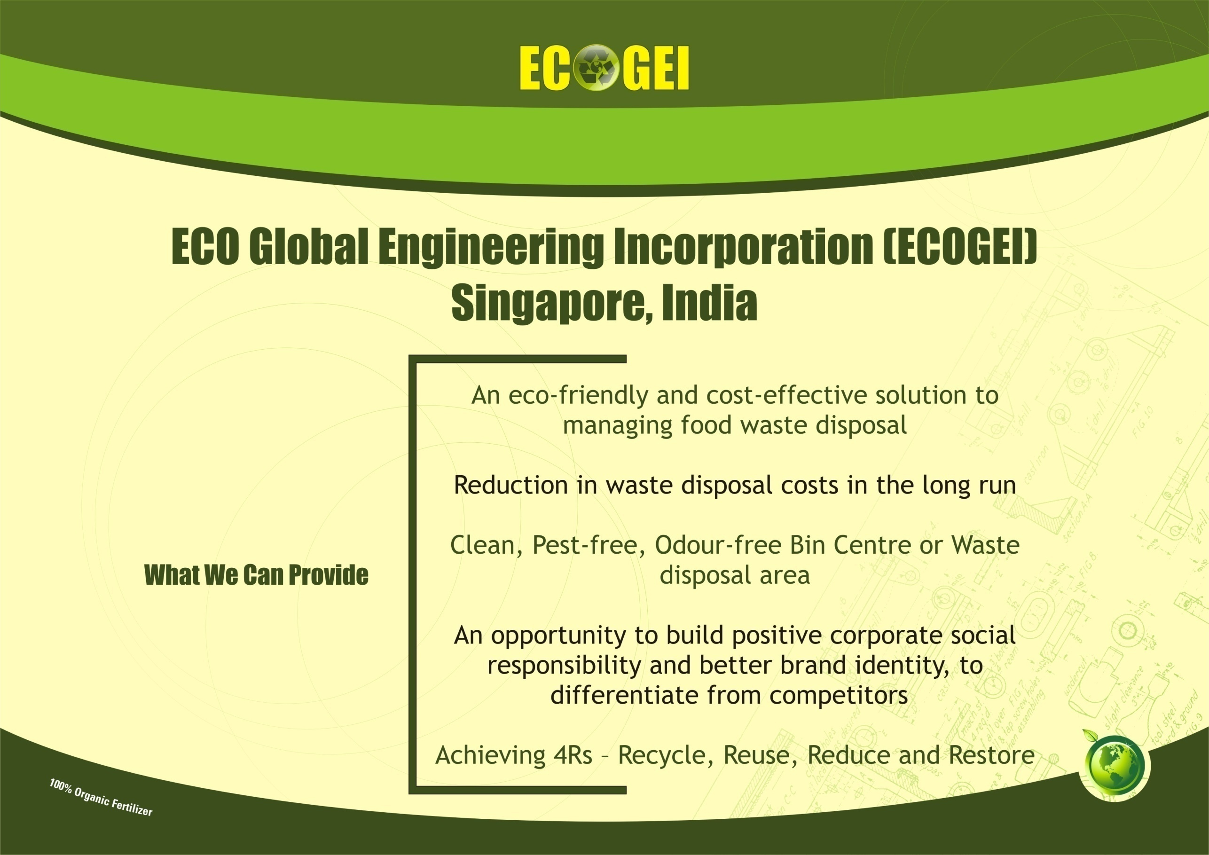

Gaps in treatment systems in most of the
Urban Local Bodies are
Non availability of Land
Lack of general awareness
Apathy of the people
Resistance of local people
Not giving adequate priority by policy decision makers
The available facilities are only partial- some sort of treatment plants alone
No comprehensive facility having segregation at source, door to door collection, transportation to the treatment plant, processing and disposal of inert materials into the landfill.
Non availability of appropriate technology
Inadequate expertise in the field

Slide 6
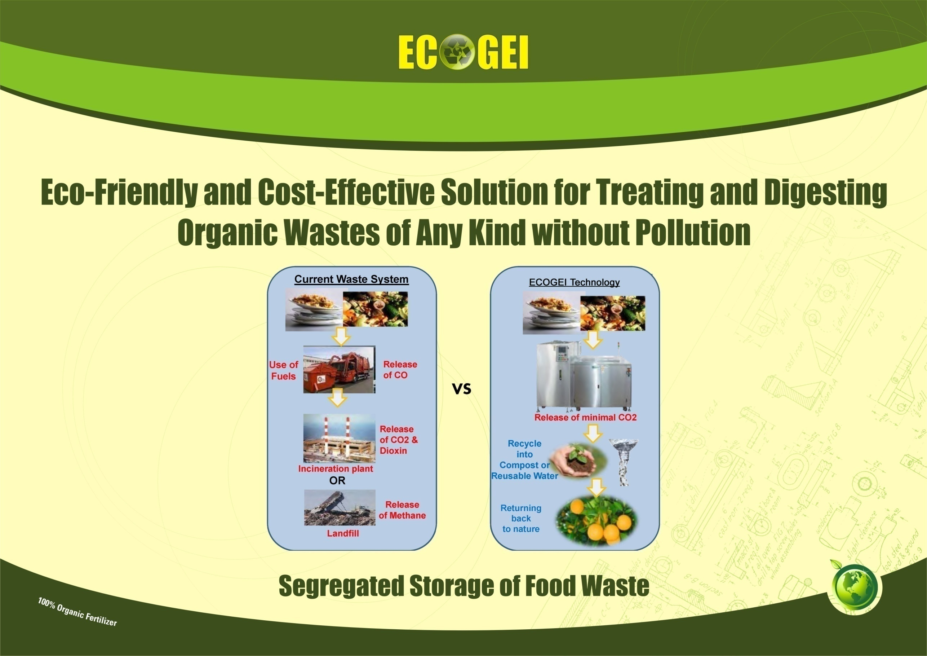


Slide 7
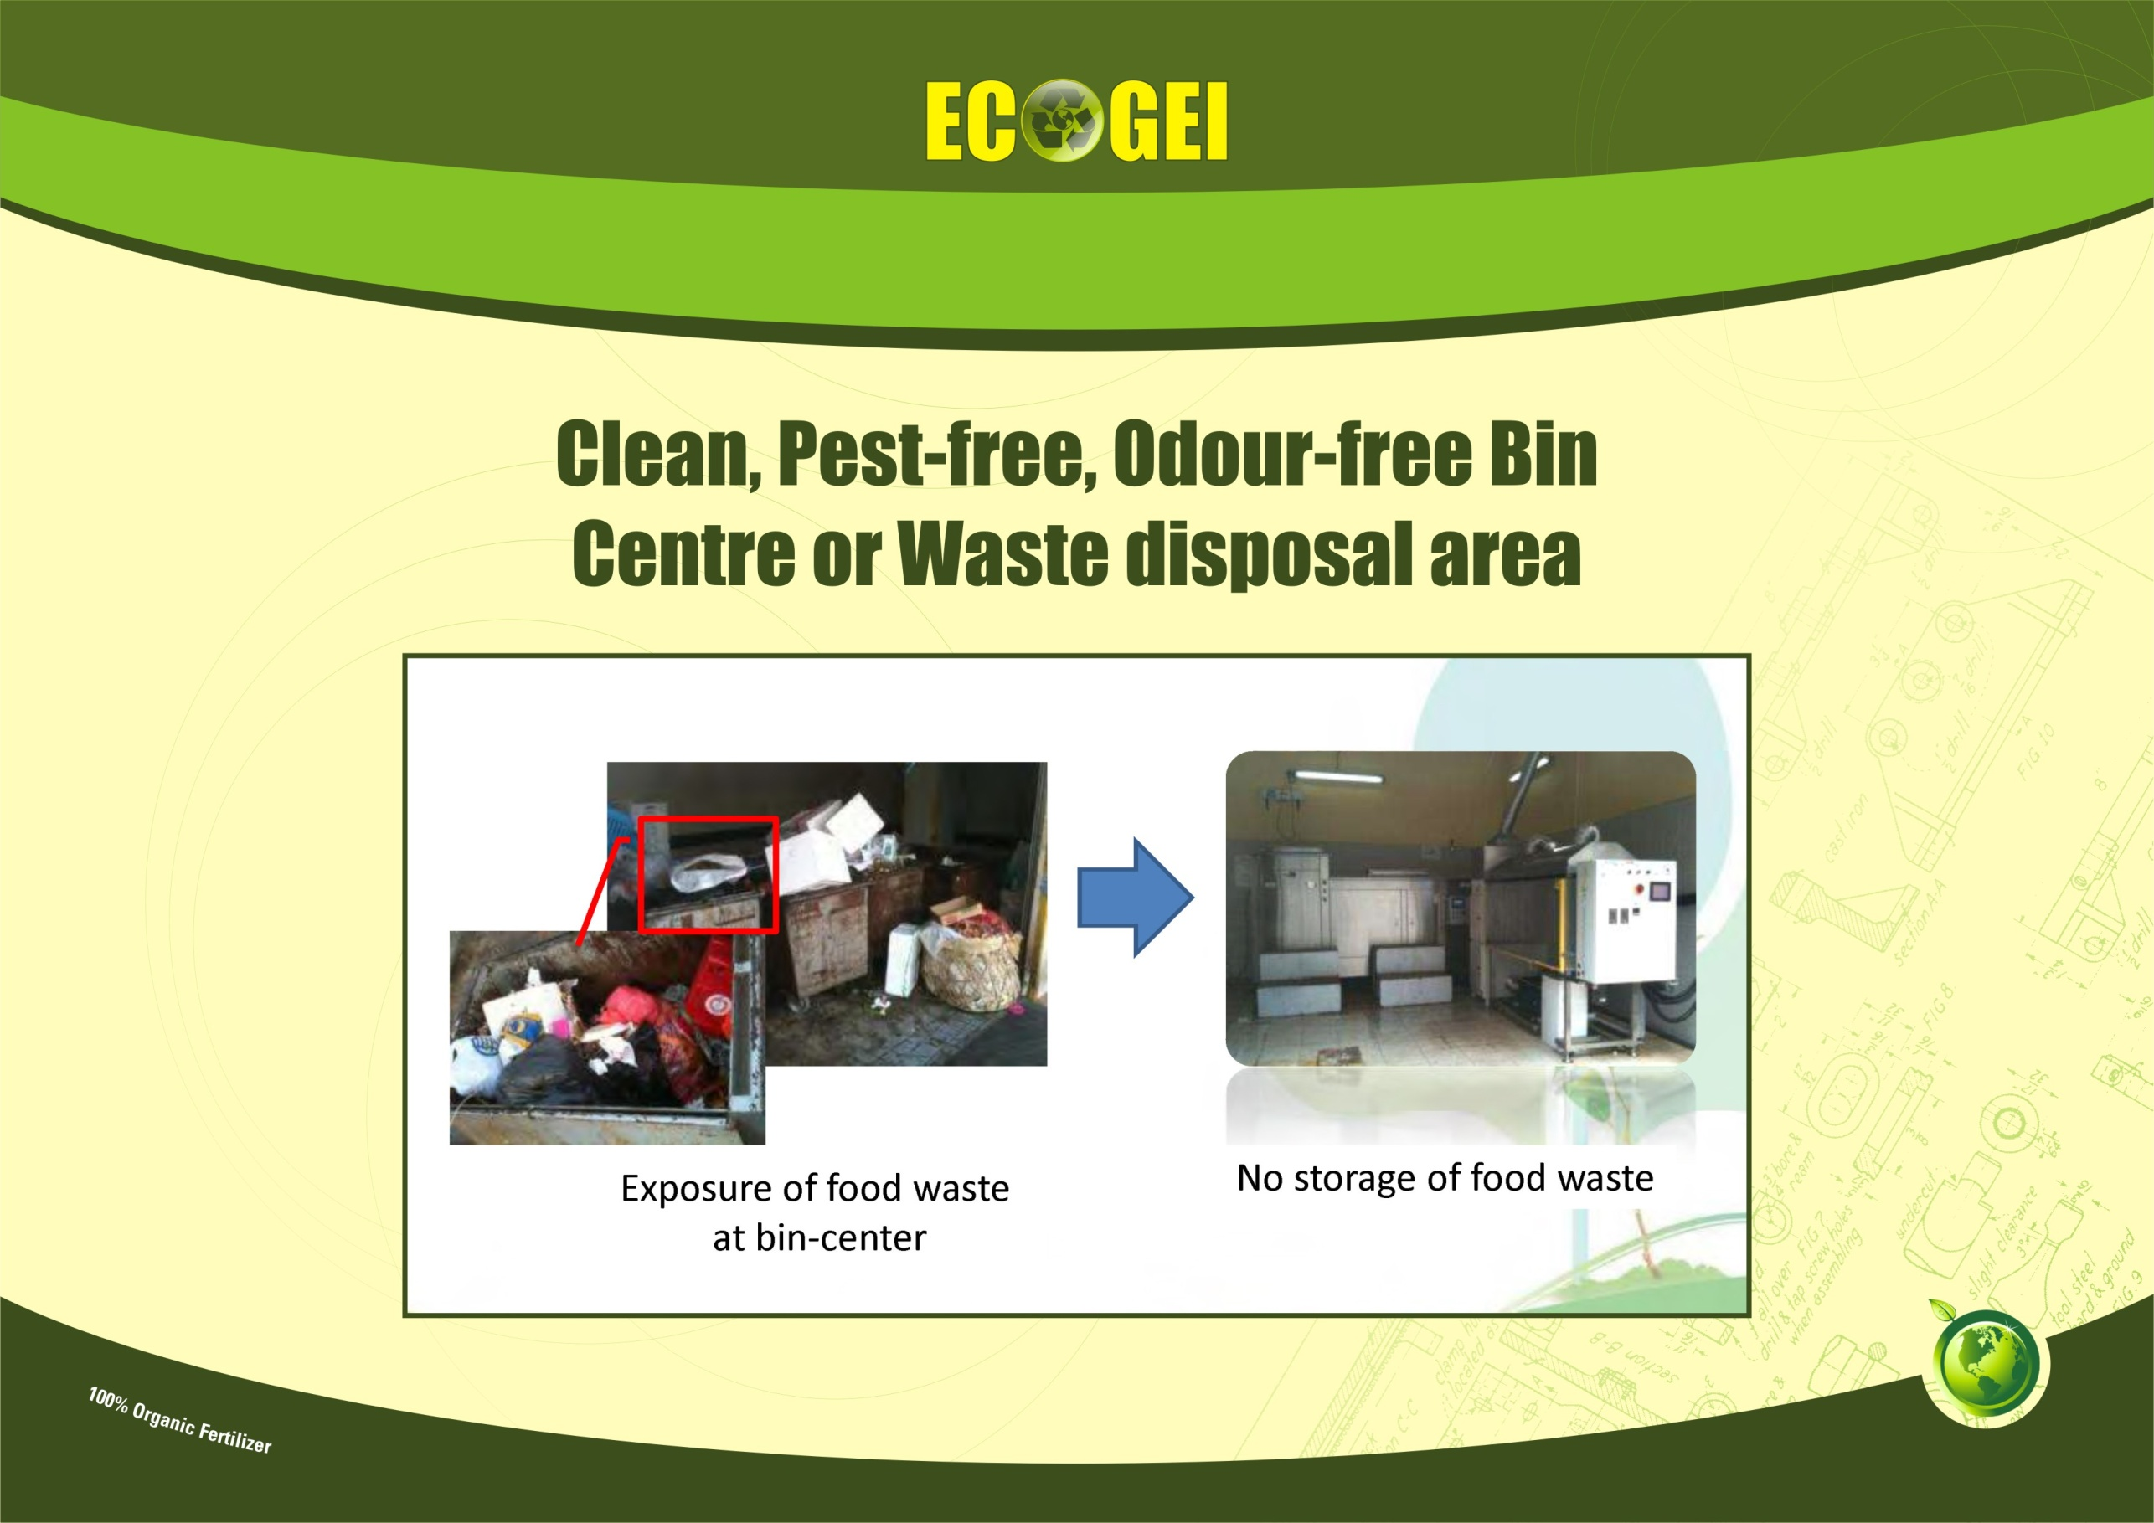
Gaps in treatment systems in most of the
Urban Local Bodies are
Non availability of Land
Lack of general awareness
Apathy of the people
Resistance of local people
Not giving adequate priority by policy decision makers
The available facilities are only partial- some sort of treatment plants alone
No comprehensive facility having segregation at source, door to door collection, transportation to the treatment plant, processing and disposal of inert materials into the landfill.
Non availability of appropriate technology
Inadequate expertise in the field

Slide 8
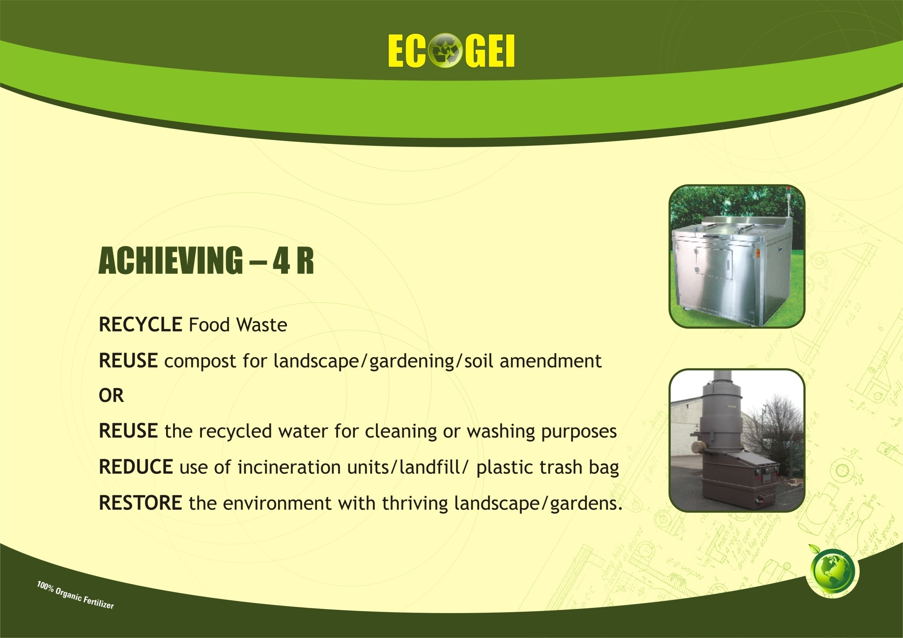

Slide 9

DEVELOPING CSR AS A COMPETITIVE ADVANTAGE
Emphasis on “Green Efforts” by Governments
Tap on the environmental advantage and build better brand identity
Strategic branding tool to differentiate from competitors
Positive CSR will build confidence and goodwill with stakeholders

Slide 10
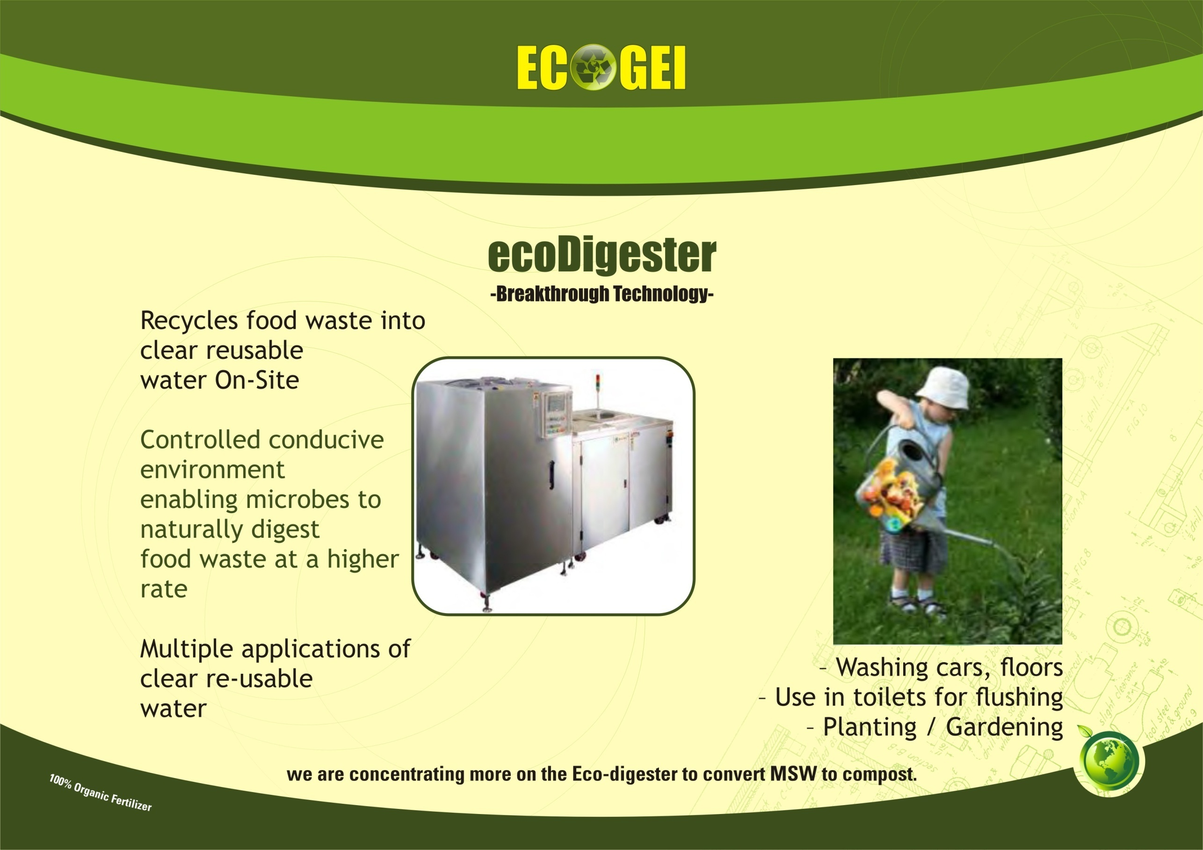
ecoDigester®
Digesting food waste into water
ecoDigester® is an entirely self-contained and continual feed disposal system for organic waste. It is designed to convert solid food waste materials into crystal-clear reusable water which can be applied for multiple purposes e.g. washing floor or watering of plants.
ecoDigester® increases the speed of the natural decomposition process through biological means like maintaining optimal levels of aeration, moisture, temperature. Under these controlled conditions, microorganisms can safely decompose food waste at a rate much faster than under natural conditions which are subjected to soil and groundwater contamination.
ecoDigester® can safely and quickly decomposes any kind of food waste including vegetables, fruits, scraps, raw and cooked meat, fish, poultries and dairy products.
The food waste enters the ecoDigester and is decomposed into sludge within 24hrs
The sludge is run through a grease separator
Followed by microbial treatment and filtration through our MBR system
The result is water which meets sewage standards
If there is a requirement to reuse the water, the result is put through a Reverse Osmosis System to further treat the water

Slide 11


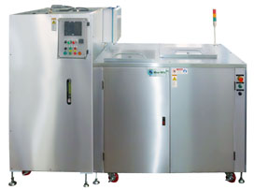
ecoDigester®
Digesting Food Waste into Water
ecoDigester® is an entirely self-contained and continual feed disposal system for organic waste. It is designed to convert solid food waste materials into crystal-clear reusable water which can be applied for multiple purposes e.g. washing floor or watering of plants.
ecoDigester® increases the speed of the natural decomposition process through biological means like maintaining optimal levels of aeration, moisture, temperature. Under these controlled conditions, microorganisms can safely decompose food waste at a rate much faster than under natural conditions which are subjected to soil and groundwater contamination.
ecoDigester® can safely and quickly decomposes any kind of food waste including vegetables, fruits, scraps, raw and cooked meat, fish, poultries and dairy products.
The food waste enters the ecoDigester and is decomposed within 24hrs
The sludge is run through a grease separator
Followed by microbial treatment and filtration through our MBR system
The result is water which meets sewage standards
If there is a requirement to reuse the water, the result is put through a Reverse Osmosis System to further treat the water

Slide 12

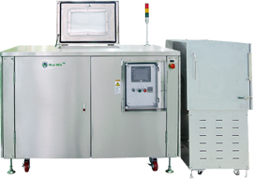
ecoDigester®
Digesting food waste into compost
ADVANTAGES
Key Features:
⇒ Virtually smoke, fumes & smell free
⇒ High temperature, refractory lining giving excellent heat retention
⇒ Quick heat up times & high burn rates of up to 500kg per hour
⇒ Easy installation and maintenance
⇒ One year warranty and full access to technical backup and support via telephone.
⇒ Compliance with the EU ABPR 1774/2002
⇒ CE Certified
⇒ Worldwide coverage
One of the main features of our incinerators range is that they burn virtually smoke and smell free without the need for a secondary burner because of their patented internal design. Not only do we supply a range of incinerators in many different sizes but we are now able to make them all fully mobile and self contained

Slide 13

ecoDigester®
Digesting Food Waste into Compost
Like the wet series, ECOGEI/Eco-Wiz® Dry Series is also an organic waste disposal system that is totally self-contained and is a continual feed. This dry series however, is meant to convert food waste materials into compost.
Apart from keeping your organic waste out of landfills, composting it will give you natural fertilizer for your lawns and gardens. This rich, sweet-smelling, soil-like substance increases the health of your soil with nutrients that are easily absorbed by plants’ roots.
ECOGEI/Eco-Wiz® Dry Series uses a natural process to decompose food wastes. We biologically manipulate the environment in the Eco-Wiz system to attract microbes that can decompose food waste at the highest speed.

Slide 14
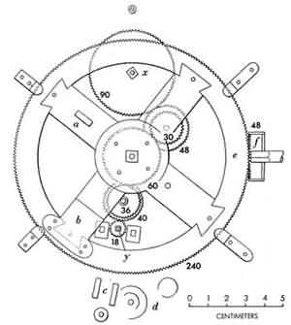

Components of ecoDigester
The main components of the ecoDigester/ecoComposter comprises of 3 parts
1) The EW System which the waste food is digested into liquid form
2) The EW System which the waste food is digested into compost form
3) The grease separator which separates the grease from the liquid
ecoDigester -Water
The MBR (Membrane Bio Reactor), this further processes the liquid into water which meets sewage standards.
ecoComposter -Compost
The MBR would be replaced with a Dry Unit to turn the liquid into compost.

Slide 16

How it works:
The ecoDigester primary function is to accelerate the natural decomposition process by maintaining optimal levels of aeration, moisture and temperature. Under this manipulated environment, our unique microorganisms safely decomposes food waste at an accelerated rate then natural decomposition without soil and ground water contamination
Its operation:
Step1: Microbes are poured into the system for
activation (system inoculation only once)
Step2: Food waste is added
Step3: System will mix food waste with the microbes
Step4: Decomposition of food waste by microbes
Step5: Discharge as liquid or compost
Step2-5: is repeated over and over within 24hrs.
We do recommend ecoDigester® for digesting food waste into compost
The Approximate Full Load Power Electricity Consumption of 1 ton Machine is 9.32Kwh (Full Load). Approximate Running Power Consumption is 2.49 kwh (ecoDigester-Water).
Approximate Full Load Power Consumption of the MBR is 9.36kwh and Approximate running Power Consumption is 2.47 kwh (ecoDigester-Compost)

Slide 17
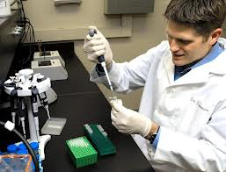
ECOGEI MICROBIAL ADDITIVE
Enzyme-enhanced microbial technology gives us the biological
tools necessary for improving organic waste management.
The liquefaction of organic waste associated with food waste is
improved and waste degradation is sped up. This is done by
introducing specialised and naturally-occurring microorganisms
with enhanced degradation capabilities into the ECOGEI Systems.
ECOGEI products work with a Microbial Additive that is specially designed and produced by our team of Bio Scientists. This additive contains a powdered blend of organisms blended with crude enzymes and emulsifiers specifically designed to digest and deodorise organic wastes.
Microbial additive is classified as BIO-Safety Level 1, making it completely safe for Human and animal contact.
We would supply Microbes and Spare Parts as and when these are required

Slide 18
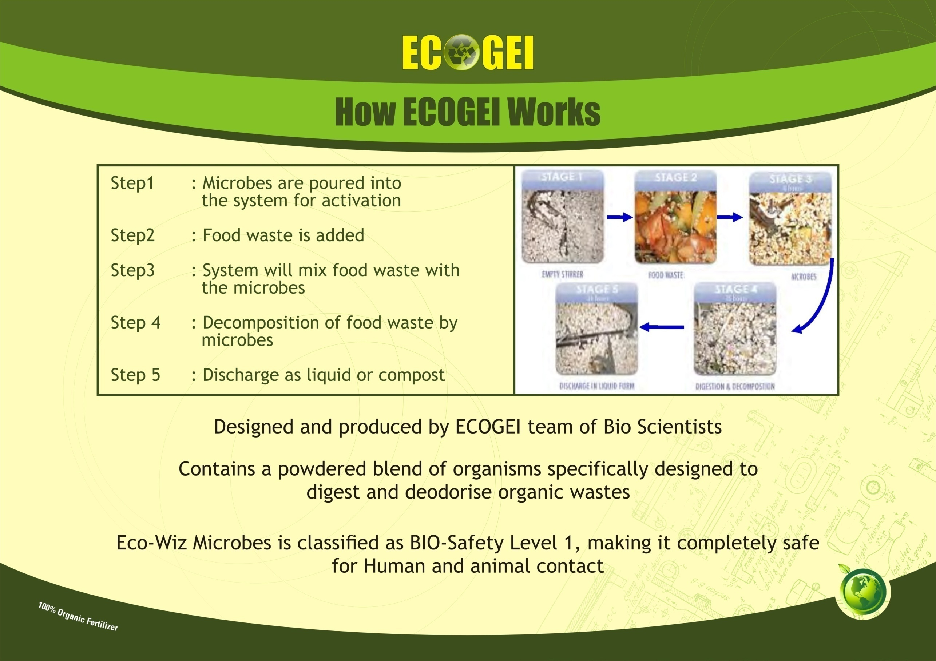
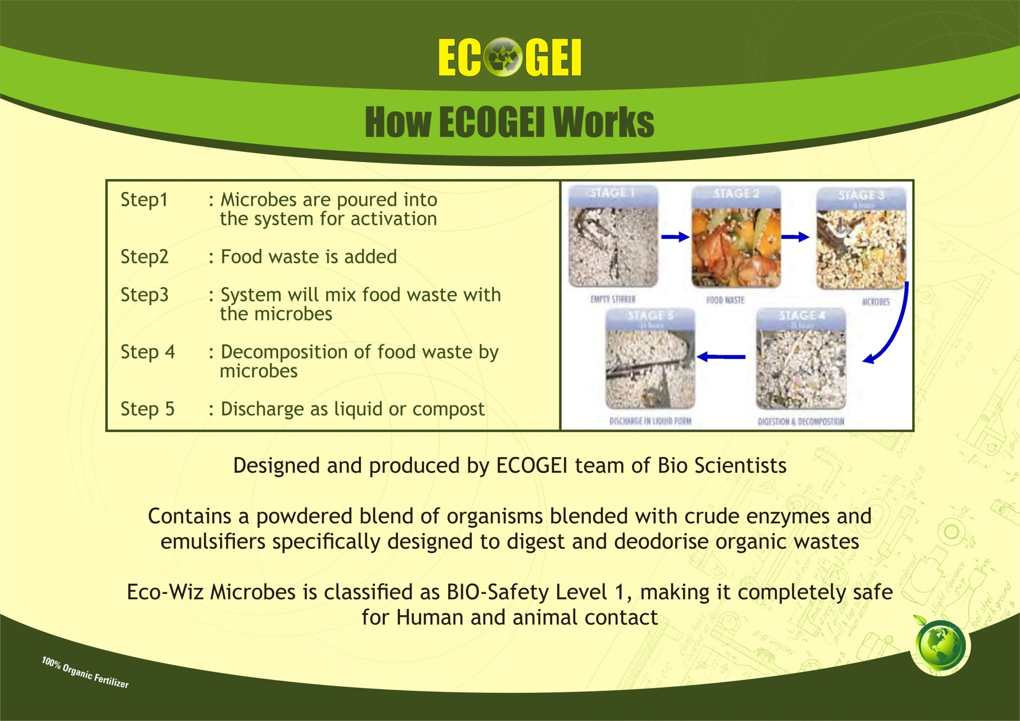
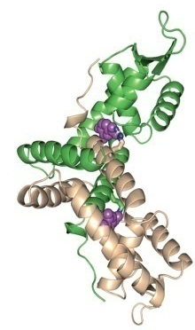
Eco- Wiz Microbial Additive
Enzyme-enhanced microbial technology gives us the biological tools necessary for improving organic waste management.
The liquefaction of organic waste associated with food waste is improved and waste degradation is sped up. This is done by introducing specialised and naturally-occurring microorganisms with enhanced degradation capabilities into the Eco-Wiz® system.
Eco-Wiz® products work with a Microbial Additive that is specially designed and produced by our team of Bio Scientists. This additive contains a powdered blend of organisms blended with crude enzymes and emulsifiers specifically designed to digest and deodorise organic wastes.
Microbial additive is classified as BIO-Safety Level 1, making it completely safe for Human and animal contact.
We would supply Microbes and Spare Parts as and when these are required.

Slide 19

ADDITION OF CHEMICALS AND ITS IMPORTANCE
There are no Chemicals involved in the ecoDigesters
Ecological benefits
Reduction of harmful emissions ➢ Transportation
– Carbon Monoxide
Reduction of vermin at Bin Centre
Cleaner environment for future generations
Economical benefits
Easy installation at site
Fully automated system
Food waste no longer stored on site,
reduce pest control
Reduction in use of plastic bags
Increase Organization Profit
How much manual work is required
Manual work on the client side would be to separate food waste from general waste before depositing the food waste into the machine.
Other than that the machine is fully automated

Slide 20

APPLICATION OF ECOGEI/ECO-WIZ ECODIGESTERS IN:
• Hotels (Singapore)
⬥ Fairmont Hotel Swissotel
⬥ The Stamford  Holiday Inn
⬥ Orchard City Centre  Hotel Continental
• Food Processing Factories (Singapore)
Country Foods
SATS foods (Under Singapore Airline)
An all rounded food service provider in Singapore
• Hospitals (Singapore)
In negotiation with
⬥ Alexandra Hospital
and
⬥ Khoo Teck Puat Hospital
• Training Institution (Singapore)
Civil Defence Academy
• Schools (USA)
Bridgewater State College
•Supermarket (Singapore)
NTUC
• Fresh Markets (Singapore)
Kovan-Hougang Fresh Market
• General Waste Company (Singapore)
Sembwaste
• Recreational Club (Singapore)
Singapore Swimming Club

Slide 21
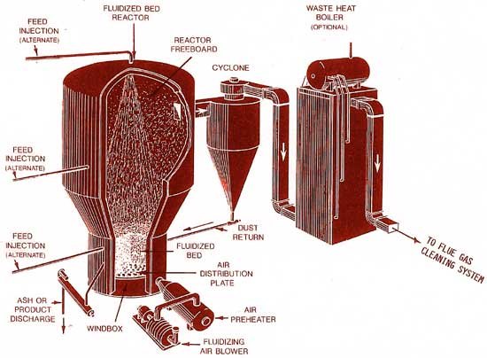
WE CAN OFFER AND PROVIDE INCINERATORS OF THE FOLLOWING:
The main uses of our Incinerators vary between the wide varieties of models we have to offer.
Our Incinerators are designed to burn all kinds of wastes, for example…
Medical Veterinary
Poultry Sheep
Pig farm Kennels
Wood / paper Industrial waste
Camp Waste Catering Waste

Slide 22
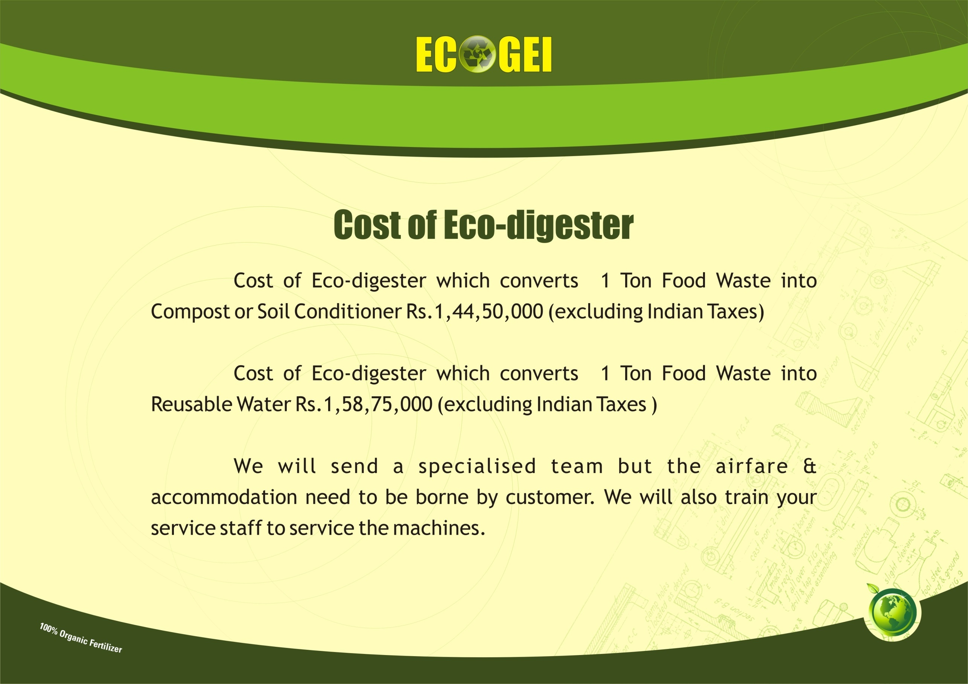
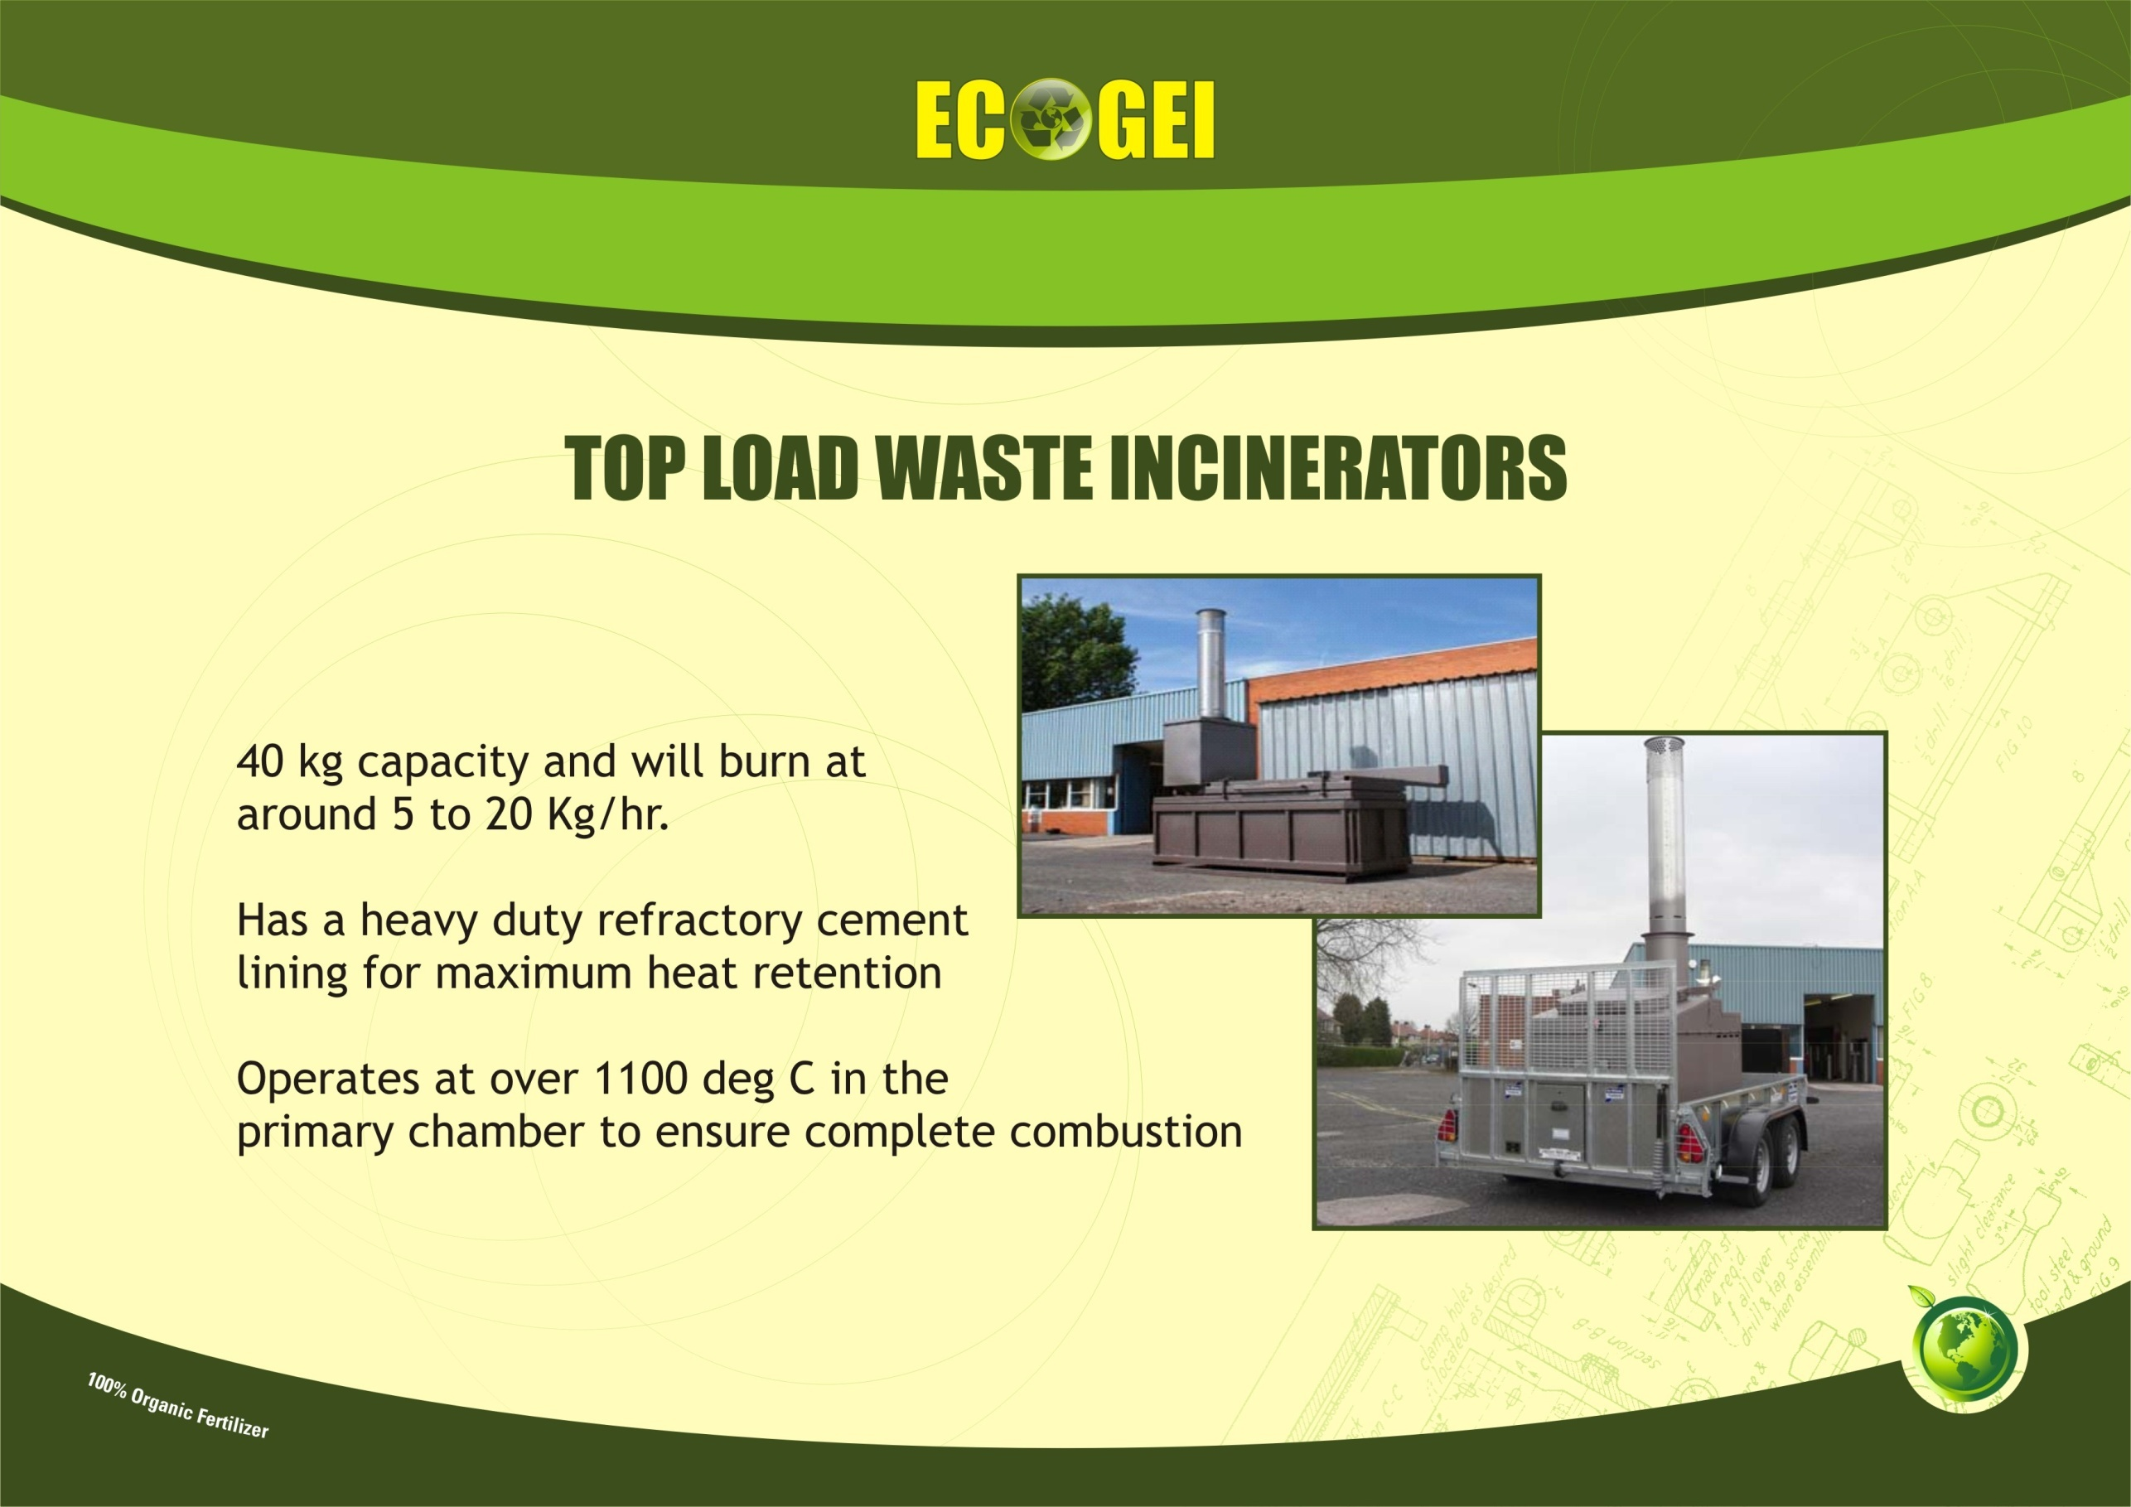
APPLICATION OF ECOGEI/ECO-WIZ ECODIGESTERS IN:
• Hotels (Singapore)
⬥ Fairmont Hotel Swissotel
⬥ The Stamford  Holiday Inn
⬥ Orchard City Centre  Hotel Continental
• Food Processing Factories (Singapore)
Country Foods
SATS foods (Under Singapore Airline)
An all rounded food service provider in Singapore
• Hospitals (Singapore)
In negotiation with
⬥ Alexandra Hospital
and
⬥ Khoo Teck Puat Hospital
• Training Institution (Singapore)
Civil Defence Academy
• Schools (USA)
Bridgewater State College
•Supermarket (Singapore)
NTUC
• Fresh Markets (Singapore)
Kovan-Hougang Fresh Market
• General Waste Company (Singapore)
Sembwaste
• Recreational Club (Singapore)
Singapore Swimming Club

Slide 23
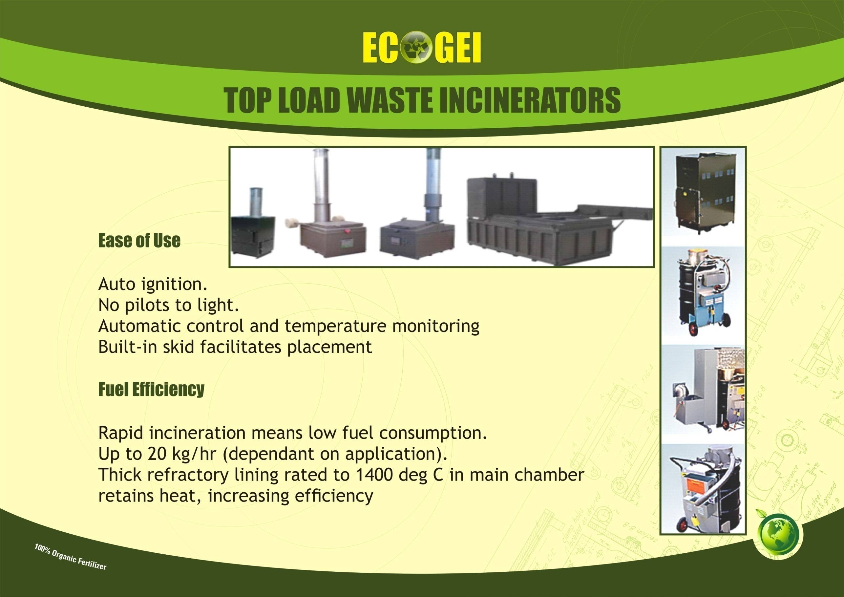
APPLICATION OF ECOGEI/ECO-WIZ ECODIGESTERS IN:
• Hotels (Singapore)
⬥ Fairmont Hotel Swissotel
⬥ The Stamford  Holiday Inn
⬥ Orchard City Centre  Hotel Continental
• Food Processing Factories (Singapore)
Country Foods
SATS foods (Under Singapore Airline)
An all rounded food service provider in Singapore
• Hospitals (Singapore)
In negotiation with
⬥ Alexandra Hospital
and
⬥ Khoo Teck Puat Hospital
• Training Institution (Singapore)
Civil Defence Academy
• Schools (USA)
Bridgewater State College
•Supermarket (Singapore)
NTUC
• Fresh Markets (Singapore)
Kovan-Hougang Fresh Market
• General Waste Company (Singapore)
Sembwaste
• Recreational Club (Singapore)
Singapore Swimming Club

Slide 24
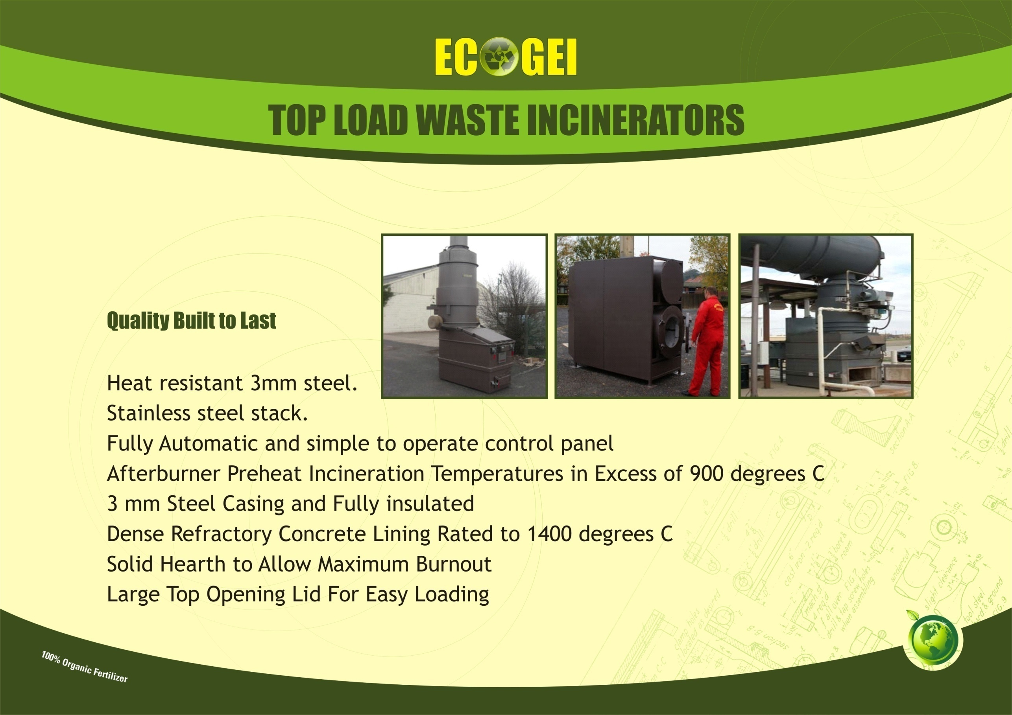
APPLICATION OF ECOGEI/ECO-WIZ ECODIGESTERS IN:
• Hotels (Singapore)
⬥ Fairmont Hotel Swissotel
⬥ The Stamford  Holiday Inn
⬥ Orchard City Centre  Hotel Continental
• Food Processing Factories (Singapore)
Country Foods
SATS foods (Under Singapore Airline)
An all rounded food service provider in Singapore
• Hospitals (Singapore)
In negotiation with
⬥ Alexandra Hospital
and
⬥ Khoo Teck Puat Hospital
• Training Institution (Singapore)
Civil Defence Academy
• Schools (USA)
Bridgewater State College
•Supermarket (Singapore)
NTUC
• Fresh Markets (Singapore)
Kovan-Hougang Fresh Market
• General Waste Company (Singapore)
Sembwaste
• Recreational Club (Singapore)
Singapore Swimming Club

Slide 25
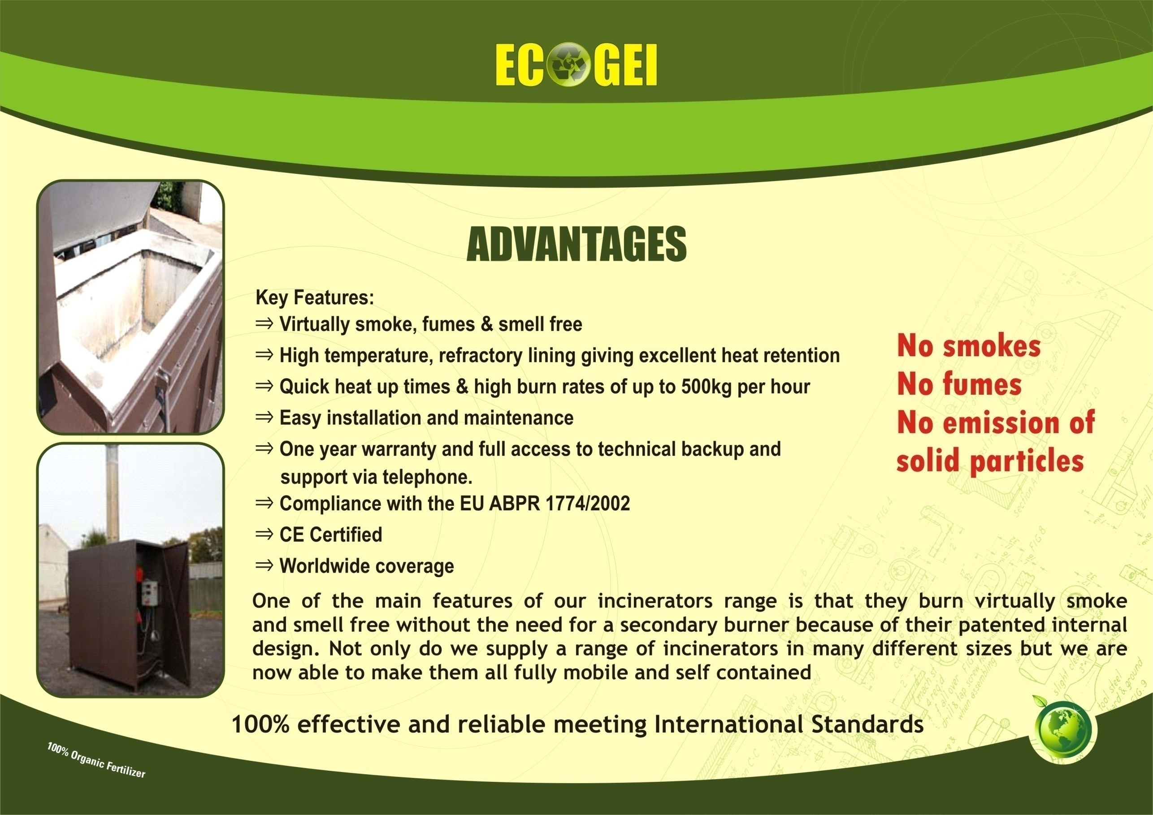
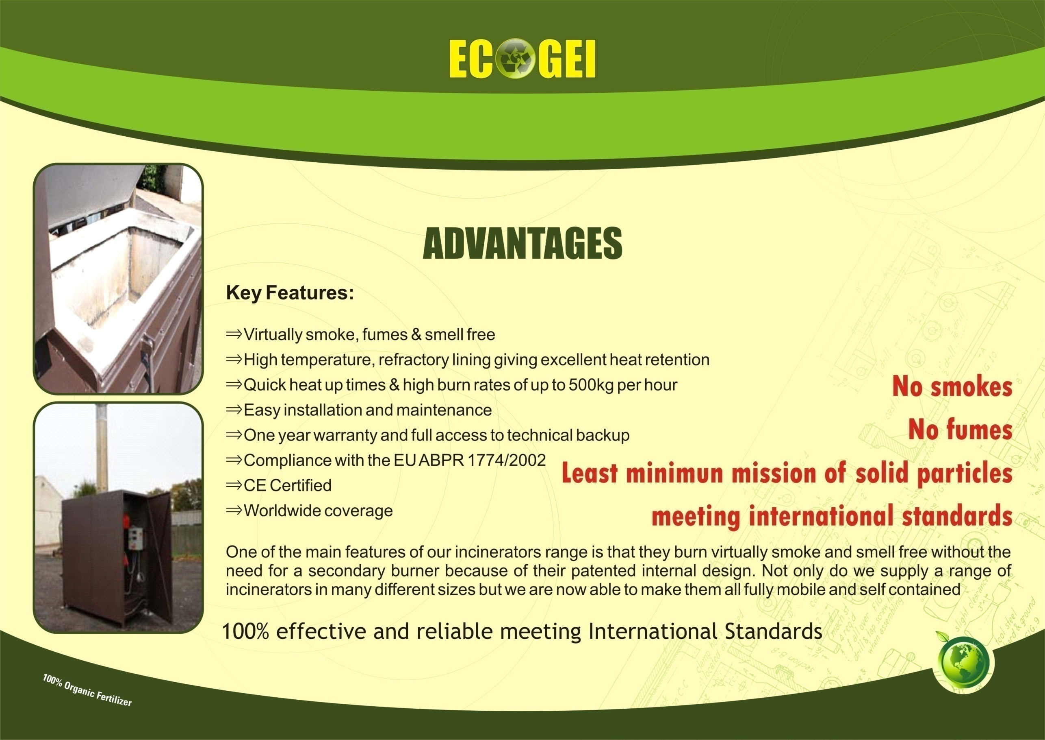


APPLICATION OF ECOGEI/ECO-WIZ ECODIGESTERS IN:
• Hotels (Singapore)
⬥ Fairmont Hotel Swissotel
⬥ The Stamford  Holiday Inn
⬥ Orchard City Centre  Hotel Continental
• Food Processing Factories (Singapore)
Country Foods
SATS foods (Under Singapore Airline)
An all rounded food service provider in Singapore
• Hospitals (Singapore)
In negotiation with
⬥ Alexandra Hospital
and
⬥ Khoo Teck Puat Hospital
• Training Institution (Singapore)
Civil Defence Academy
• Schools (USA)
Bridgewater State College
•Supermarket (Singapore)
NTUC
• Fresh Markets (Singapore)
Kovan-Hougang Fresh Market
• General Waste Company (Singapore)
Sembwaste
• Recreational Club (Singapore)
Singapore Swimming Club

Slide 26
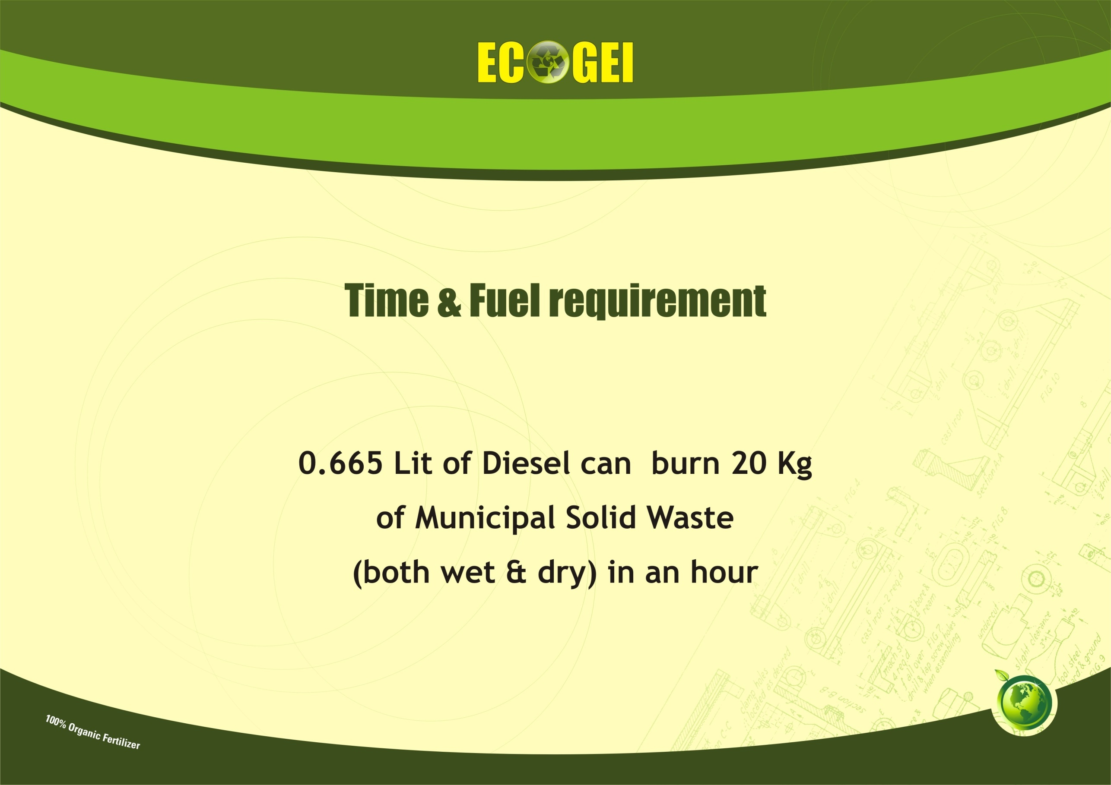
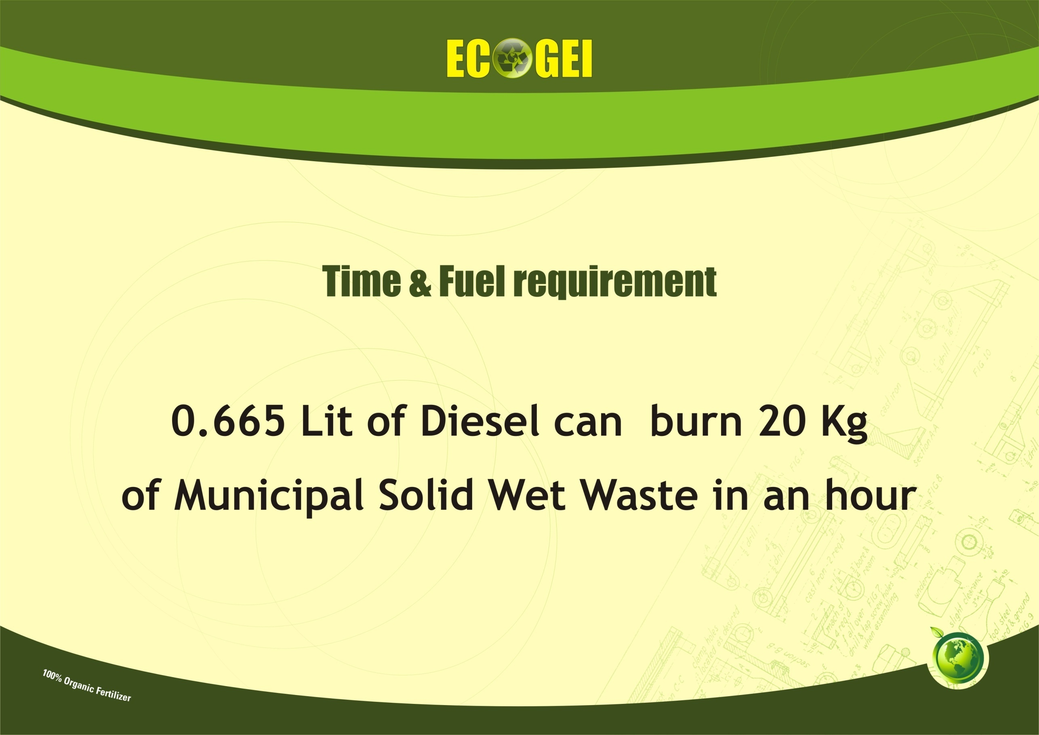

APPLICATION OF ECOGEI/ECO-WIZ ECODIGESTERS IN:
• Hotels (Singapore)
⬥ Fairmont Hotel Swissotel
⬥ The Stamford  Holiday Inn
⬥ Orchard City Centre  Hotel Continental
• Food Processing Factories (Singapore)
Country Foods
SATS foods (Under Singapore Airline)
An all rounded food service provider in Singapore
• Hospitals (Singapore)
In negotiation with
⬥ Alexandra Hospital
and
⬥ Khoo Teck Puat Hospital
• Training Institution (Singapore)
Civil Defence Academy
• Schools (USA)
Bridgewater State College
•Supermarket (Singapore)
NTUC
• Fresh Markets (Singapore)
Kovan-Hougang Fresh Market
• General Waste Company (Singapore)
Sembwaste
• Recreational Club (Singapore)
Singapore Swimming Club

Slide 27
WE CAN OFFER AND PROVIDE INCINERATORS OF THE FOLLOWING:
The main uses of our Incinerators vary between the wide varieties of models we have to offer.
Our Incinerators are designed to burn all kinds of wastes, for example…
Medical Veterinary
Poultry Sheep
Pig farm Kennels
Wood / paper Industrial waste
Camp Waste Catering Waste

Slide 28

Short Form List Of Recent Incinerator Customers
Halliburton Co. - Germany & Libya
Enqua Kft -Hungary
STS Hostivice – Czech Republic
D. Matsoulis & H. Bletsas – Greece
Chore Time Europe – Netherlands
AVICOLA LUMINA S.A – Romania
SC “Mineral Protan Agigea” SA - Romania
SC Carnob SRL Lumina – Romania
STS – Slovakia
Agrovet Plus - Belarus
PCF - Azerbaijan
Royal Palace – Jordan
United Nations – Northern Cyprus
Gvardia - Stavropol Kray, Russia
Business Yemen for Trading- Yemen
US Army, USA
US Navy, USA
British Foreign Office, USA
USONA, UK
BP Oil, UK
Pet cremation services - Singapore
Chem Labs - Kenya
Grampian Food Group - U.K.
PD Hook Agriculture - U.K.
Fugro Marine - Netherlands
Kosovo Government (Agriculture) - Kosovo
KCA Deutag - Germany
Naval Medical Research Unit - Egypt
Shell Oil, Libya
Medecins Sans Frontiers (MSF) - Cambodia
BGP – China
Kumasi Medical Centre – Ghana
Peregrine Diamonds - Canada
Matrix Helicopters - Canada
City of Lucedale - USA
Norwegian Red Cross - Sudan
Cancer Hospital - Maharagama, Sri Lanka
Kandy Teaching Hospital - Sri Lanka
Peradeniya Teaching Hospital - Sri Lanka
Medical research Institute - Sri Lanka
Welisara Hospital - Sri Lanka
Intraskins - Belgium
RA International - Afghanistan, Chad

Slide 29
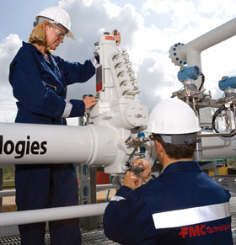
INSTALLATION, COMMISSION, OPERATION
AND
MAINTENANCE
Company Engineers from Singapore would install and commission the machineries. Company Engineers would train service staff to operate and service the machines.
Spare Parts of Machineries and Microbes will be supplied by ECOGEI, India in association with Singapore, as and when these are required for.

Slide 30
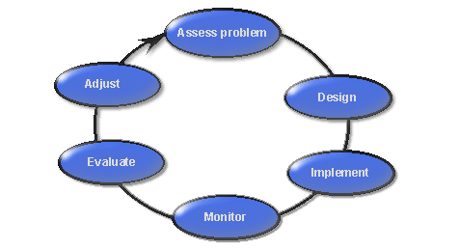
MANAGEMENT STEPS REQUIRED FOR:
Management steps required for handling of the machineries, maintenance, and compost received from the ecoDigester, such as classifying screening, whether there is any inert material, how to manage this material, operating and handling machineries, storage of compost required.

Slide 31
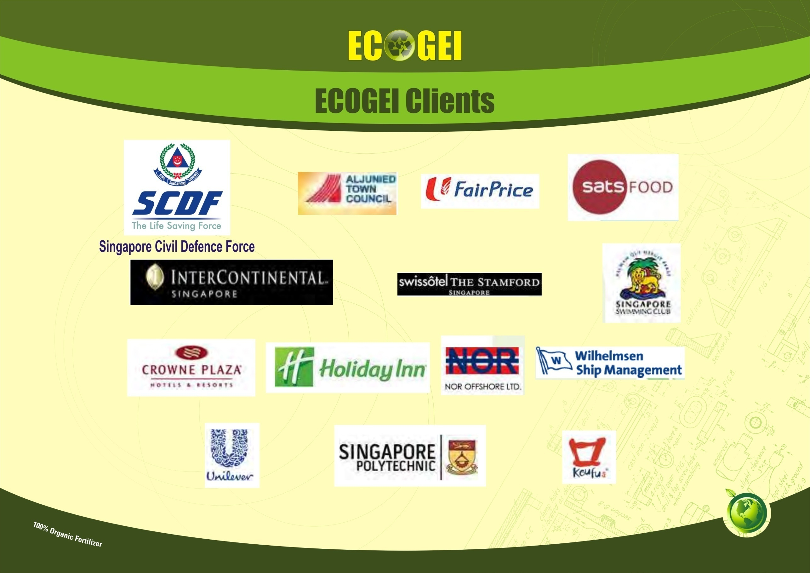

Slide 32


Slide 33
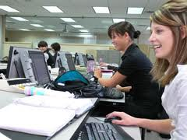
More Details & Trade Enquiry:
www.ecogei.com

